Slide 1

Intelligent alert system for forest tribal people using IBM Watson Studio
Team Members:
Dayanidhi
Jyothi
Sri Latha
Varun
Sri Laasya

Slide 2

INTRODUCTION
.
. A tribe is a group of people who live and work together in a shared geographical area. A tribe has a common culture, dialect and religion. They also have a strong sense of unity. The tribe is usually
headed by a chief. A tribal society is a group of tribes organized around kinships. Tribes represent a
part in social evolution between bands and nations.
. Tribal people constitute 8.6% of the nation's total population, and most of them spend the greater part of their lives in the proximity of trees and villages or clans near to the forest. There are so many
challenges faced by these people out of which Human-wildlife conflict (Human-wildlife conflict refers
to the interaction between wild animals and humans, and the resultant negative impact on people,
animals, resources, and habitats) is a serious challenge undermining the protection of tribal regions
.

Slide 3














I N T R O D U C T I O N
.
The major types of human-wildlife conflict in the area include crop-raiding,
livestock predation, increased risk of livestock diseases, and direct threats to
human life. so Active measures are to be implemented to mitigate these
problems and safeguard the future of the wildlife. Hence we came up with
this Project “Intelligent Alert System”. This ensures the complete safety of
humans who lives near the forests by notifying the wild animal predation before
it enters the clan.

Slide 4
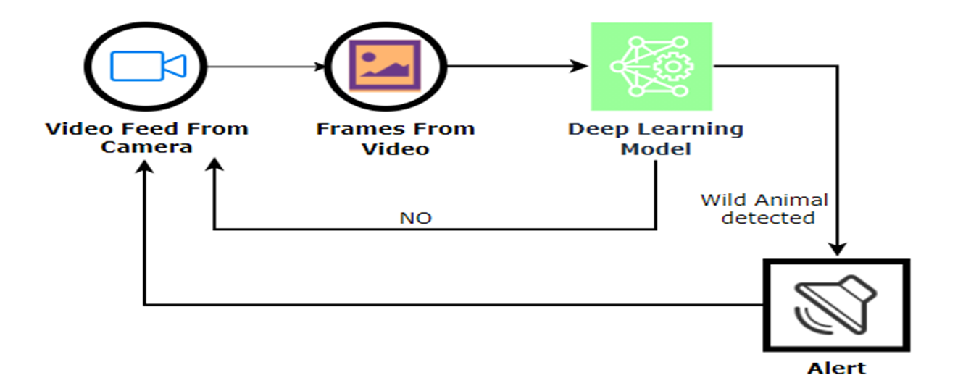
FRAME WORK
.

Slide 5
CONCLUSION:
Intelligent alert system for forest tribal people model based on neuralnetworks(CNN) incorporated with an alerting system.
This system will monitor the entire villages of surrounding forests at regular intervals through a camera .
Once any dangerous animal is detected then it will send
information to the people in the village by a message alerting them with the image of the animal

Slide 6
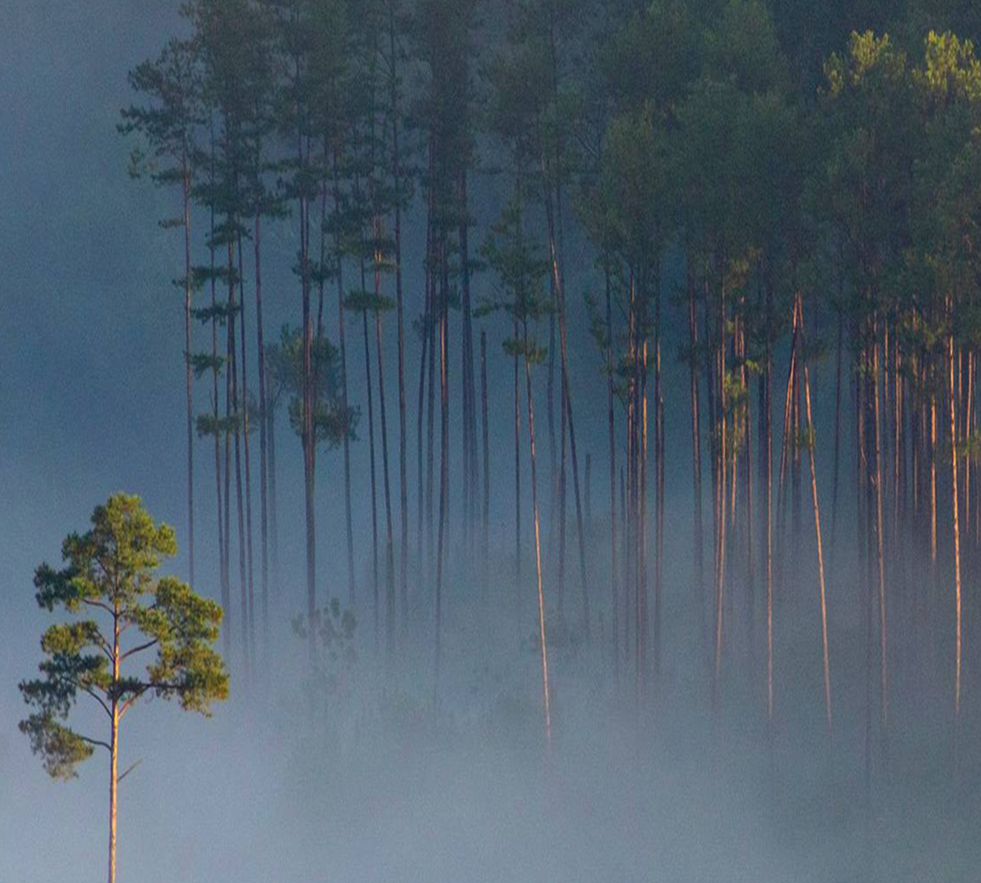
THANK YOU

